Slide 1
Software Project Lab - 1
Google’s PageRank Algorithm
Presented by Shah Alam Abir

Slide 2
Table of contents
CONTENTS
1
Introduction
4
Random Surfer Model
2
The web as a Graph
5
PageRank Formula
3
Why we should RANK webpages

Slide 3
1
Introduction

Slide 4
Google's PageRank Algorithm is an algorithm used by Google Search Engine to rank web pages in search engine results.
It was developed by Larry Page and Sergey Brin, the co-founders of Google, while they were graduate students at Stanford University.
Introduction

Slide 5
PageRank is designed to assess the importance and relevance of web pages in the context of search engine results.
The underlying idea is that valuable and authoritative web pages are more likely to be linked to by other web pages.
Therefore, a web page with many high-quality incoming links is considered more valuable and is likely to rank higher in search results.
Introduction

Slide 6
2
The web as a Graph

Slide 7
The web as a Graph
We can represent WWW’s structure as a huge directed graph, where node’s of that graph are the webpages and edges are the links between webpages.
C
B
F
A
E
D

Slide 8
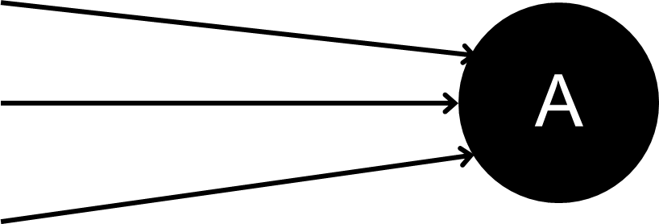
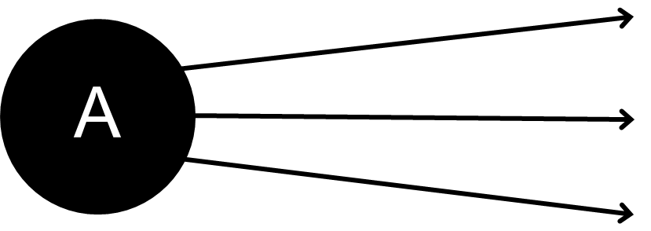
The web as a Graph
Inbound links are links that point from another website to the target website
Outbound links are links that point to another websites from target website

Slide 9
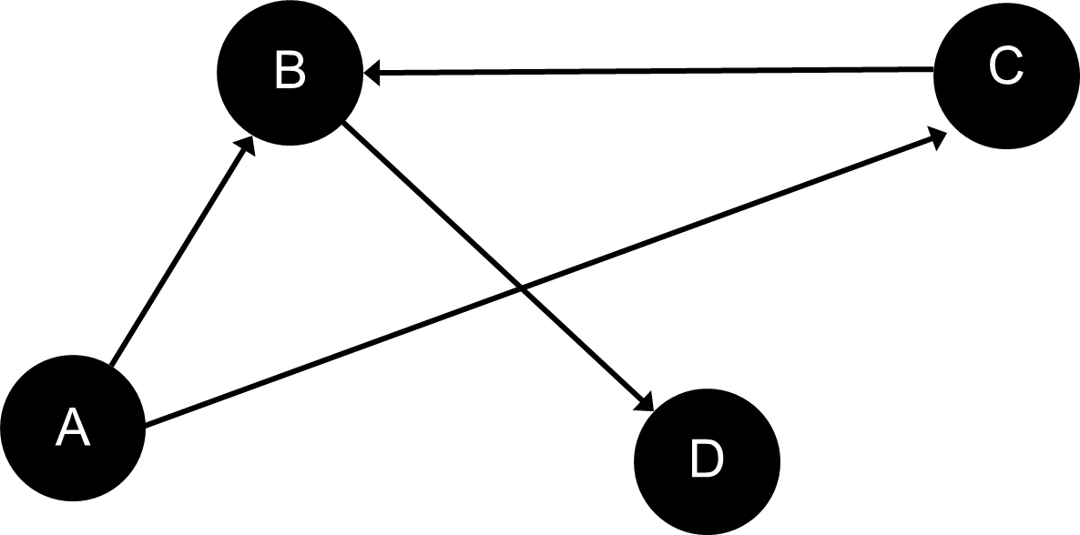
The web as a Graph
Dangling Nodes are the nodes with no outbound links
Dangling Links are links that point to the dangling nodes
Here D is a Dangling Node
BD is a dangling Link

Slide 10
3
Why we should RANK webpages

Slide 11
Why we should RANK webpages
Relevance
Efficiency
Accessibility
Academic and Research Insights
Trustworthiness

Slide 12
4
Random Surfer Model

Slide 13
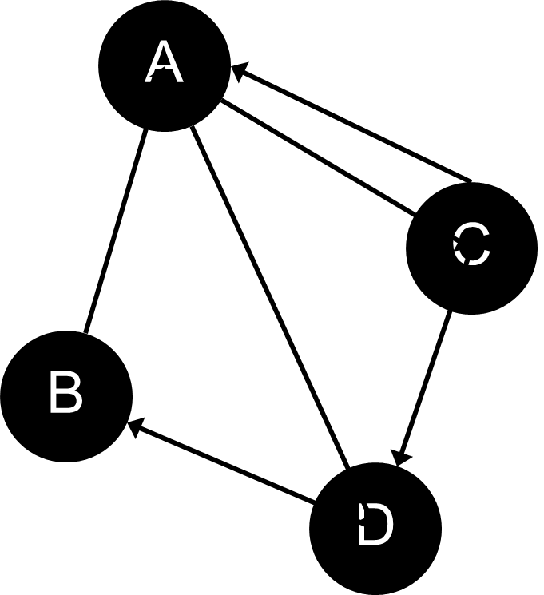
Random Surfer Model
The Random Surfer Model is a conceptual framework used in the context of web page ranking algorithms, particularly in understanding Google's PageRank algorithm. It is a simplified representation of how a hypothetical internet user behaves when navigating the web and is used to explain the concept of PageRank.

Slide 14
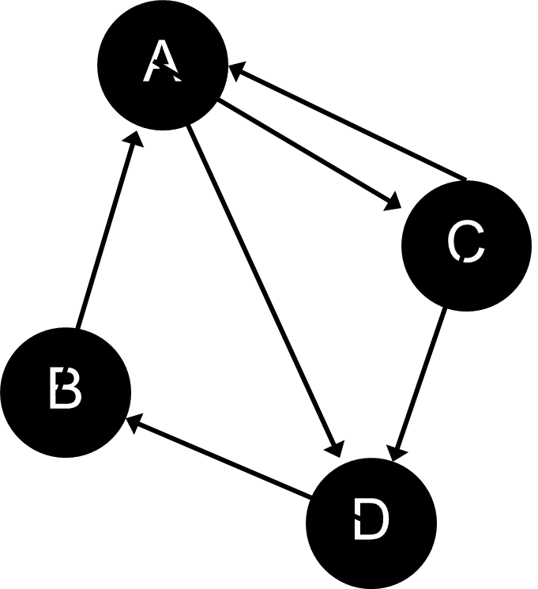


Random Surfer Model
Matrix Presentation
 | A | B | C | D
A | 0 | 0 | 0.5 | 0.5
B | 1 | 0 | 0 | 0
C | 0.5 | 0 | 0 | 0.5
D | 0 | 1 | 0 | 0
$$r_{(k+1)}\left(P_{i}\right)= \sum_{{Pj∈B_{P}}_{j}}{\frac{r_{k} (P_{j})}{|P_{j}|}}$$
The PageRank of a page $P_{i}$, denoted $r(P_{i})$, is the sum of the Page-Ranks of all pages pointing into $P_{i}.$
where $B_{P_{i}}$ is the set of pages pointing into $P_{i}$ and |$P_{j}$| is the number of out-links from page $P_{j}$ .
Transition matrix H

Slide 15
Random Surfer Model (Iterative Calculation)
Initializing page rank for every page with 1/n. Where, n is the total number of webpages of the graph. Thus, we will have another matrix X with initialized page-rank value.
A | ¼
B | ¼
C | ¼
D | ¼
From previous slide we got Transition matrix H
We will perform matrix multiplication X = HX iteratively until it converge. Then we will get a modified page-rank matrix X.
Now, if we sort them according to probability, then we will get webpages in descending order.
Matrix X

Slide 16
Problems with Random Surfer Model
But, there is two major problem with this Random Surfer Model. These are –
If there is any dangling node [webpage], then all the elements of the final matrix will be 0.
If some nodes of the graph is highly connected, then probability of these particular group of nodes becomes significantly higher then other nodes. Because of this, a random surfer iterates through a group of nodes again and again.

Slide 17
5
PageRank Formula

Slide 18
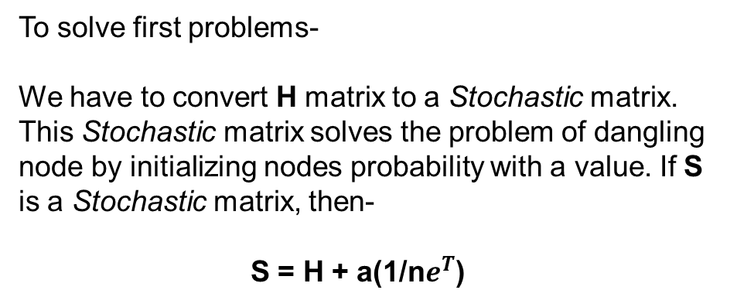
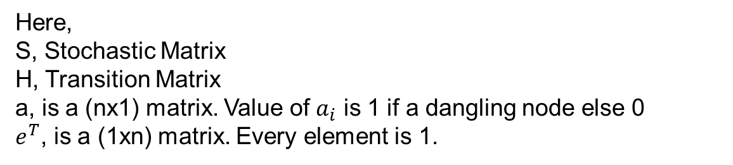
PageRank Formula
To solve first problems-
We have to convert H matrix to a Stochastic matrix. This Stochastic matrix solves the problem of dangling node by initializing nodes probability with a value. If S is a Stochastic matrix, then-
S = H + a(1/n$e^{T}$)
Here,
S, Stochastic Matrix
H, Transition Matrix
a, is a (nx1) matrix. Value of $a_{i}$ is 1 if a dangling node else 0
$e^{T}$, is a (1xn) matrix. Every element is 1.

Slide 19


PageRank Formula
To solve second problems-
We have to make GOOGLE (G) matrix from S matrix & H matrix. This G matrix ensures teleportation from the dense part to the sparse part of the graph. If G is a GOOGLE matrix, then-
G = $αS+(1−α)\frac{1}{α}ee^{T}$ = $αH+\left(αa+\left(1−α\right)e\right)\frac{1}{n}e^{T}$
Here,
G, GOOGLE Matrix
S, Scholastic Matrix
H, Transition Matrix
a, is a (nx1) matrix. Value of $a_{i}$ is 1 if a dangling node else 0
$e,$is a (nx1) matrix. Every element is 1
$e^{T}$, is a (1xn) matrix. Every element is 1.
α, is the damping factor. It ensures the teleportation.
Damping Factor
The damping factor in the PageRank algorithm is a parameter that represents the probability that a random surfer, navigating the web by clicking on links, will continue to browse and click on links within the current web page rather than jumping to a completely random page.

Slide 20

PageRank Formula
Now, we got our final formula to make a GOOGLE matrix by doing Stochastic adjustment & Primitive adjustment of the initial Transition matrix, H.
G = $αS+(1−α)\frac{1}{α}ee^{T}$ = $αH+\left(αa+\left(1−α\right)e\right)\frac{1}{n}e^{T}$
Now, We will perform Iterative matrix multiplication X = HX until it converges. Then we will get a modified page-rank matrix, X.
Now, if we sort matrix X according to probabilistic value, then we will get webpages in descending order.

Slide 21

Thank you

